Slide 1
Trailer for Introductory Resource &
Mini Modules for Teaching with Patient Care

Slide 2
Introductory Resource for Teachers in the UG & PG Medical Programs, UBC
In the Introductory resource you can find:
Mini Modules on teaching with patient care
Links to modules on teaching without patient care
Information on
Assessment & Curriculum
Learner feedback to teachers
Help and administrative support
https://facdev.med.ubc.ca/welcome-to-the-faculty-of-medicine/

Slide 3
Mini Modules for Teaching with Patient Care
New clinical teachers will find it useful to start their teaching journey by exploring the 4 introductory mini modules in the Teaching with Patient Care section.
Experienced teachers will find the practical scenarios helpful for revisiting their collaborative teaching practices.
Notes:
Please post the links to the mini modules in the chat by cutting and pasting the following:
Co-Creating Mutual Goals: https://rise.articulate.com/share/xzjmwPq3qzCyYBj4jDvsYoinPnqCX05G
Direct Observation and Feedback: https://rise.articulate.com/share/0jsQZx4qmv-YlH1PfdIFVxoOrCPJhw4n
Probing Clinical Reasoning through Collaborative Questioning: https://rise.articulate.com/share/IhQBX9l70rIqF2US6zF-FMJ5q1qvS1Qr
Reflection and Feedback Conversations: https://rise.articulate.com/share/6R56UQzUkNktp3DrsXYn-yD5N9k_j116

Slide 4
Each module takes 15-20 minutes to complete and contains two real-world scenarios of teacher-learner interactions, both with a medical student and a resident. The conversations unfold differently based on the level of the learner.

Slide 5
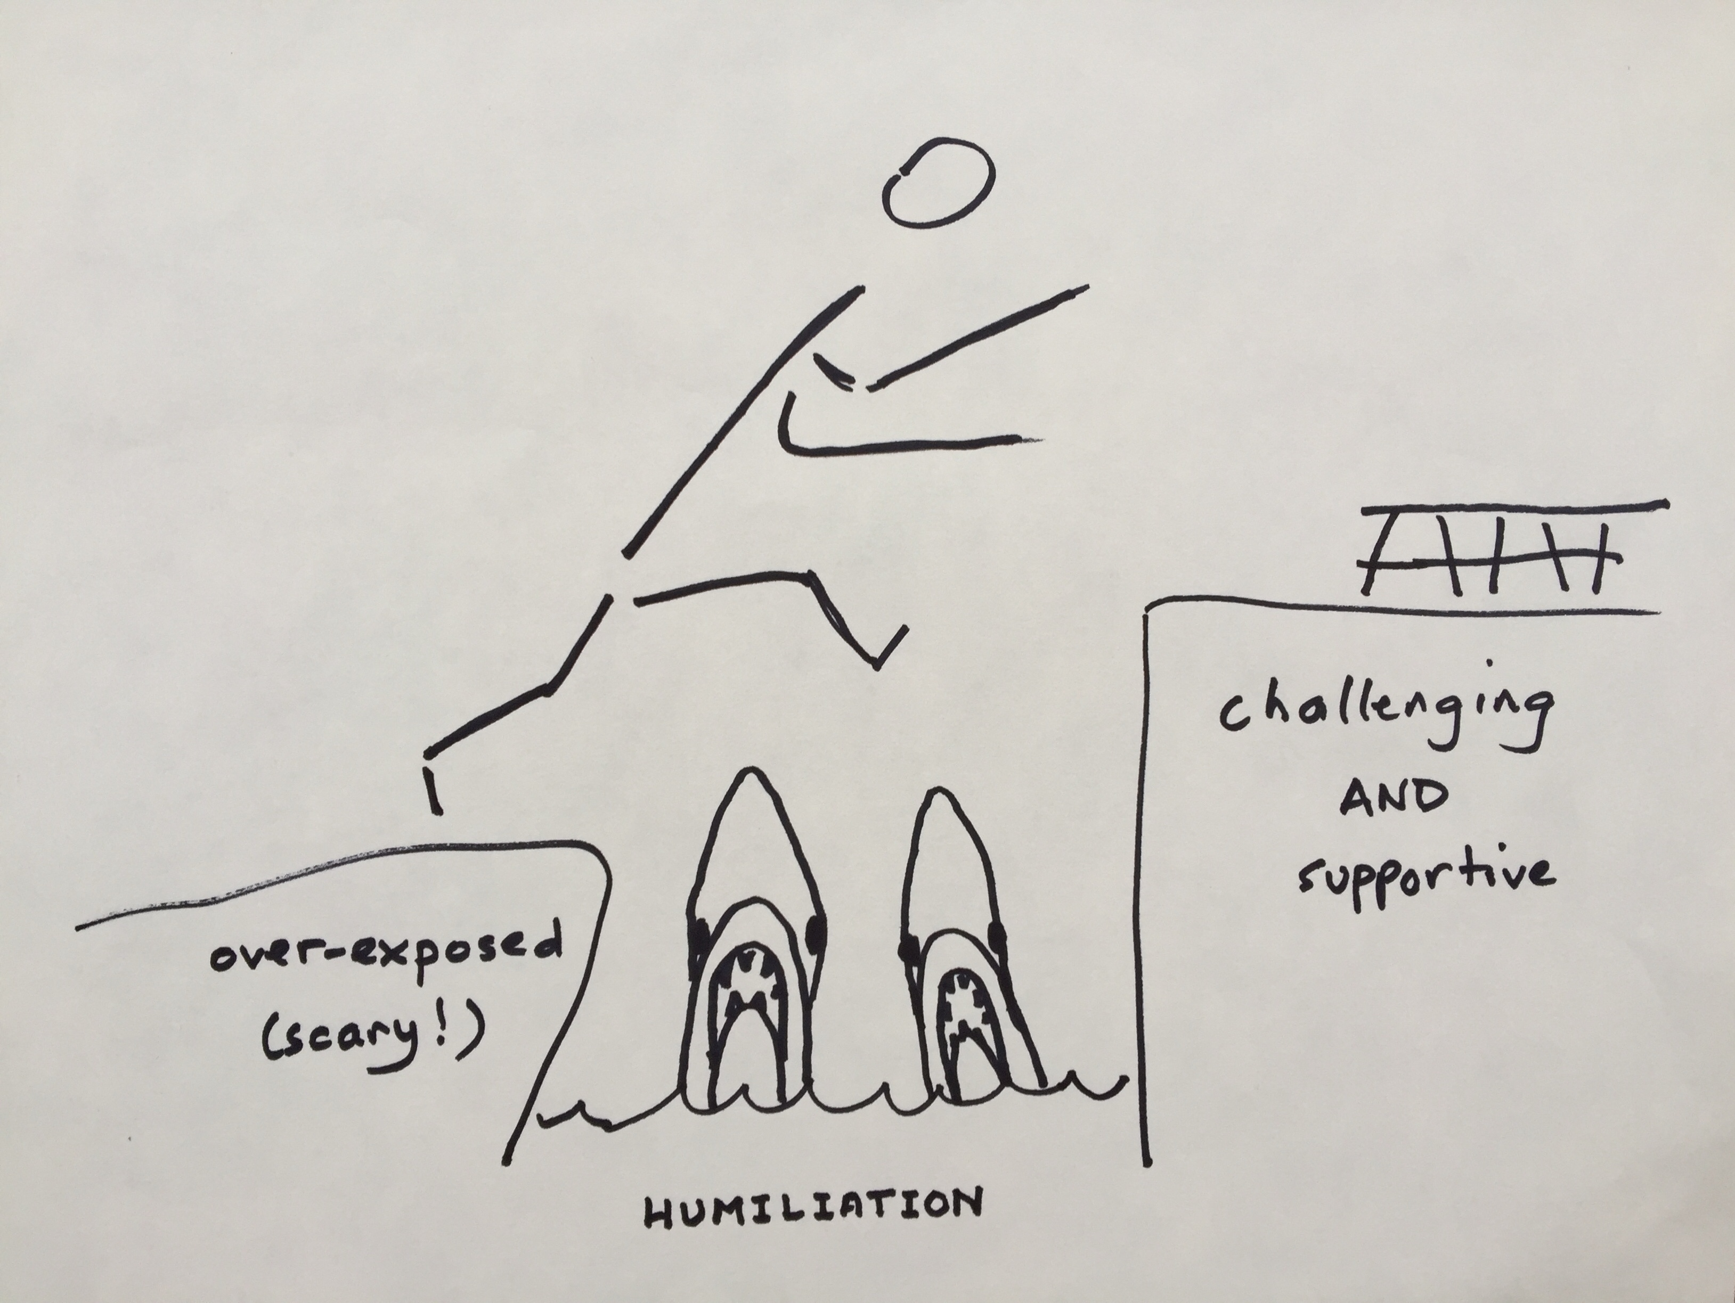
Rationale
In the clinical years learners acquire knowledge and skill through direct experience under your supervision.
The four mini-modules illustrate best teaching practices infused with UBC’s core values of:
Respect
Integrity
Compassion
Collaboration
Equity
Notes:
The modules enact our core values:
Respect, by creating a safe, supportive and inclusive learning environment
Integrity, by modelling honest and ethical practice
Compassion, by showing kindness and empathy
Collaboration, by developing an educational alliance with the learner
Equity, by striving to meet learners where they are

Slide 6
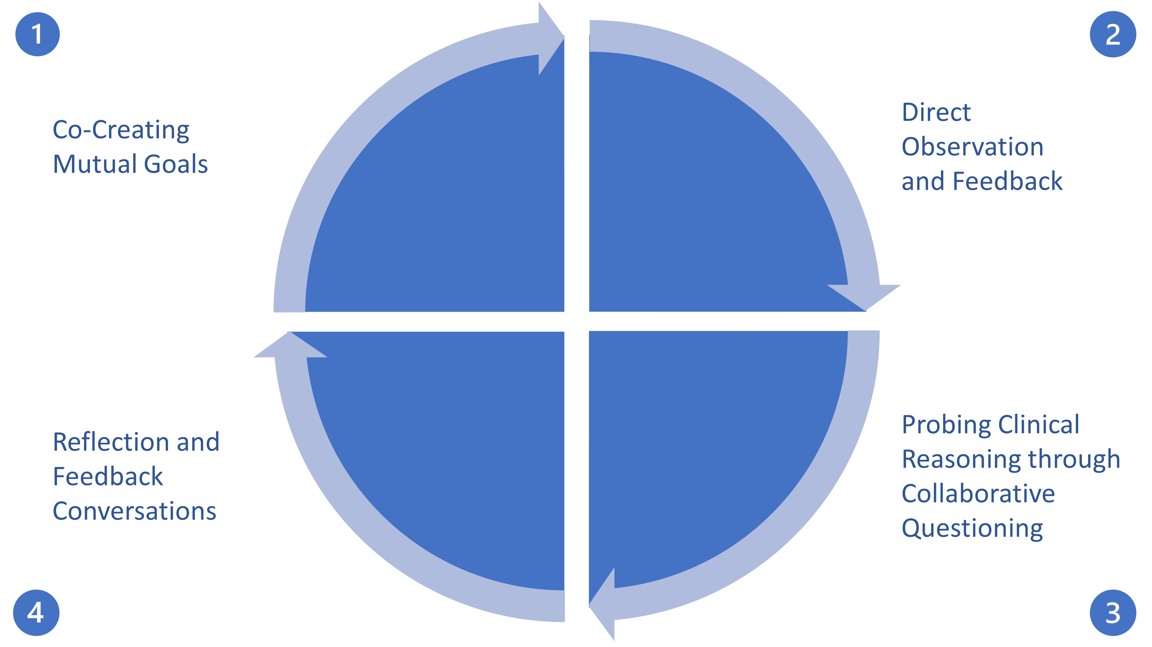
Each module covers a critical step in the teaching process and describes how our core values are enacted through collaboration with learners:
Forging an educational alliance
Meeting the learner where they are
Exploring knowledge and planning next steps
Renewing the alliance

Slide 7
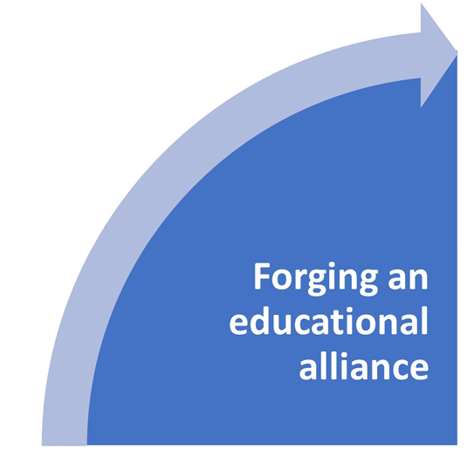
Co-Creating Mutual Goals
An educational alliance reframes learning & feedback as a dialogue and negotiation rather than simply transmission of information.
Explores the question: How do you co-construct goals that are learner centered but not exclusively learner driven?

Slide 8
Co-creating Mutual Goals - Key Takeaways
Meeting the learner as a person initiates the educational alliance
The learner carries the chief responsibility for what they learn, so probing a learner’s personal goals is key to co-constructing goals
Patient availability and your own educational priorities as a teacher shape the learner's goals
Within an educational alliance, goals are learner centered but not exclusively learner driven

Slide 9
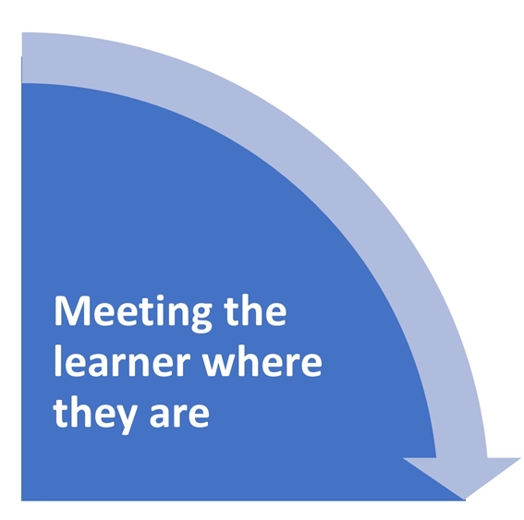
Direct Observation and Feedback
Direct observation allows experience of a learner's actual activities and competencies in patient care.
Explores the question: How do you observe and foster improved clinical skills?
This Photo by Unknown Author is licensed under CC BY-ND

Slide 10
Direct Observation & Feedback - Key Takeaways
Direct observation of a clinical task allows you to gain insight into a learner's level of practice
Direct observation provides you an opportunity to give specific feedback on learners’ goals for task improvement

Slide 11
Probing Clinical Reasoning through Collaborative Questioning
Inviting questions from learners and creating a balance between support and challenge for all participants.
Explores the question: How do you provide appropriate support and challenge while avoiding humiliation?

Slide 12
Probing Clinical Reasoning Through
Collaborative Questioning- Key Takeaways
Trust and explicit intention to collaborate is vital to learning since questioning comes with the risk of the humiliation of "not knowing"
Two-way questioning promotes self-directed learning
Graceful management of uncertainty and not knowing establishes safety
Questioning in a group using special methods avoids perpetuation of hierarchical dominance

Slide 13
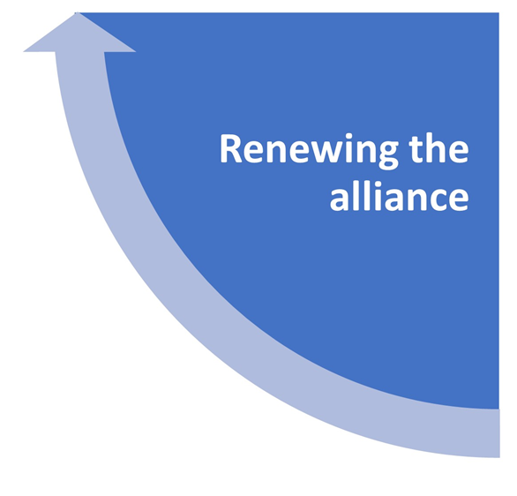
Reflection and Feedback Conversations
The sharing of thoughtful insights with a learner allows them to become more directly aware of shifts and changes in their knowledge and skill.
Explores the question: How do you share effective feedback and encourage growth through reflection?

Slide 14
Reflection And Feedback Conversations - Key Takeaways
Reflection is the cornerstone of building, retaining, and refining new knowledge and skill in medicine and in education, whether learning or teaching
Sharing of perspectives deepens self-awareness and strengthens the educational alliance, especially when each individual positions themselves as a learner along a continuum
Feedback discussions establish plans for further learning for all participants

Slide 15
Do the questions we explored resonate with you?
How do you co-construct goals that are learner centered but not exclusively learner driven?
How do you observe and foster improved clinical skills?
How do you provide appropriate support and challenge while avoiding humiliation?
How do you share effective feedback and encourage growth through reflection?
What other questions should we explore?
Contact: fac.dev@ubc.ca
This Photo by Unknown Author is licensed under CC BY-SA-NC

